Slide 1










Analysis of carbon emission reduction contribution during usage phase of new energy vehicles based on big data
A CASE STUDY OF TIANJIN
Presented by Reetam Das

Slide 2
Introduction
Increasing global attention to greenhouse gas emissions reduction
China's dual carbon strategy
Importance of NEVs in reducing transportation sector emissions

Slide 3






NEV Monitoring in Tianjin
Tianjin New Energy Vehicle Monitoring Platform
Data recorded since 2017
Types of data: vehicle ownership, mileage

Slide 4




Overall Carbon Emission Reduction
Total Reduction (2022): 171,400 tons
Average Annual Reduction per Vehicle: 0.721 tons
Significance: Highlights the impact of NEVs on reducing carbon emissions
Methodology
Baseline Emission (BE) Calculation
Project Emission (PE) Calculation
Equation: ER = BE - PE

Slide 5

Technological Types of NEVs
Battery Electric Vehicles (BEVs): 73% of total reduction, 126,000 tons
Plug-in Hybrid Electric Vehicles (PHEVs): 27% of total reduction, 45,500 tons
Conclusion: BEVs are more effective due to higher ownership and performance
Vehicle Types
Cars: 116,000 tons (67.7%)
Sport-Utility Vehicles (SUVs): 43,700 tons (25.5%)
Multi-Purpose Vehicles (MPVs): 1,400 tons (0.8%)
Minibuses: 400 tons (0.2%)
Key Insight: Cars dominate due to high market penetration

Slide 6

Total Reduction (2022): 171,400 tons
Vehicle Classes
A-Class: 70,800 tons (41.3%)
B-Class: 49,200 tons (28.7%)
A00-Class: 20,000 tons (11.7%)
C-Class: 11,900 tons (6.9%)
A0-Class: 9,300 tons (5.5%)
Observation: A-Class vehicles lead in emission reductions

Slide 7

Analysis
Baseline Emission
Project Emission
Baseline emissions refer to the estimated amount of greenhouse gases (GHGs) or pollutants that would have been released into the atmosphere if a specific mitigation project or intervention had not been implemented.
Project emissions refer to the greenhouse gas (GHG) emissions produced as a direct result of a specific project or activity. This concept is integral to the evaluation of environmental impacts and the effectiveness of mitigation strategies, particularly in sectors such as energy, transportation, industry, and land use.

Slide 8
Calculations
Baseline Emission Calculation
Project Emission Calculation
Fuel consumption, VMT, and fuel type of ICEVs
Electricity consumption, VMT of NEVs, and grid emission factor

Slide 9
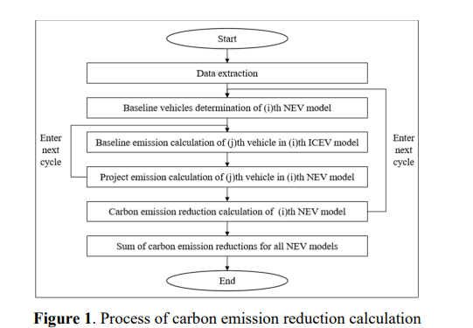
Data Collection Process
To calculate the carbon emission reduction contribution of NEV during usage phase, it is necessary to first extract data from the Tianjin NEV safety monitoring platform, including the configuration parameters of the NEV models, such as electricity consumption, curb weight, vehicle type and level, as well as the actual driving mileage data of the vehicles. Based on the vehicle configuration parameters of different NEV models, baseline vehicles can be determined, which should have the same transportation service capacity as the NEV models. According to Equation (2) and Equation (3), the baseline emissions and project emissions of different vehicles can be calculated, and then the carbon emission reduction contribution can be calculated using Equation (1). The overall process of carbon emission reduction contribution calculation based on NEV monitoring big data

Slide 10
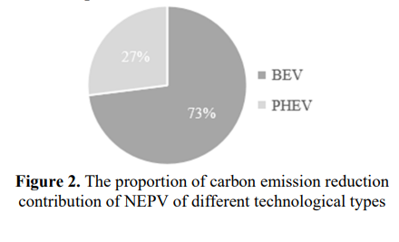
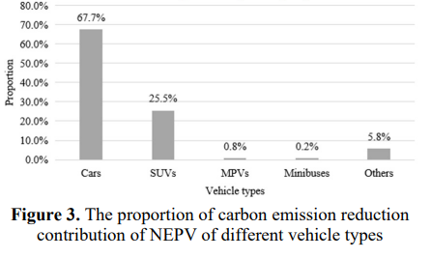
Contribution by Technology Type
BEV: 126,000 tons (73%)
PHEV: 45,500 tons (27%)
Contribution by Vehicle Type
Cars: 116,000 tons (67.7%)
SUVs: 43,700 tons (25.5%)

Slide 11
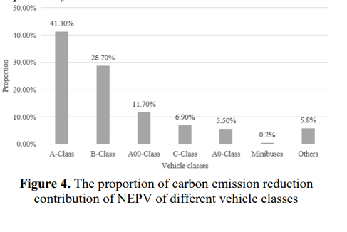
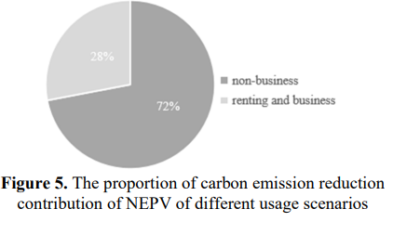
Contribution by Vehicle Class
A-class: 70,800 tons (41.3%)
B-class: 49,200 tons (28.7%)
Contribution by Usage Scenario
Non-business: 123,900 tons (72%)
Renting and business: 47,500 tons (28%)

Slide 12
Key Aspects
Influencing Factors
Policy Implications
Future Strategies
Higher Ownership of BEVs: Contributes significantly to overall reductions
Supportive Policies: Government subsidies, tax rebates, charging infrastructure
Driving Patterns: Regular, predictable routes maximize electric vehicle benefits
Incentives for NEVs: Continued government support needed
Infrastructure Development: Expansion of charging networks
Emission Standards: Stricter regulations for PHEVs
Optimize carbon reduction strategies using NEV monitoring data
Encourage the use of renewable sources for electricity
Enhance NEV technology and performance

Slide 13
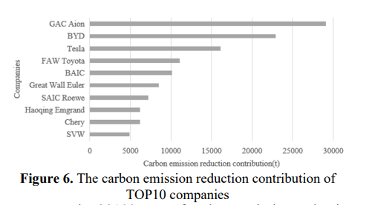
Top 10 Companies Contribution

Slide 14
Conclusion
Summary: NEVs play a crucial role in reducing carbon emissions in Tianjin
Impact: Significant contributions from BEVs and private cars
Future Focus: Continued support and optimization of NEV deployment and usage

Slide 15
Thank you!
By Reetam Das
PRODUCTION ENGG
3RD YEAR 2ND SEM
GUIDED BY - PROF. SUBIR KUMAR DEBNATH

